Slide 1

Protection Gap campaign
Rehab Jameel, MPhil (Cantab)
Protection Gap Advocates, Asylum Aid
Debora Singer MBE
Senior Policy Adviser, Asylum Aid

Slide 2

Protection Gap campaign

Slide 3

guarantee and publicise the right to request a female interviewer and interpreter

Slide 4

provide childcare
during screening
and asylum interviews

Slide 5

deliver comprehensive and mandatory training for interviewers and interpreters on sexual violence, trauma and memory

Slide 6

provide trauma counselling for women who have experienced gender-based harm

Slide 7

provide information about the asylum process, rights and entitlements specific to women seeking asylum

Slide 8
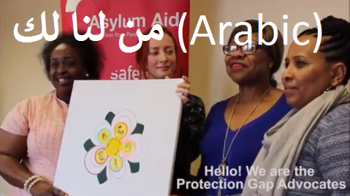
From Us to You
https://www.youtube.com/watch?v=sEBRar9ww8o&feature=youtu.be

Slide 9

DIRECTIVE 2012/29/EU OF THE EUROPEAN PARLIAMENT AND OF THE COUNCIL
of 25 October 2012
establishing minimum standards on the rights, support and protection of victims of crime
Notes:
Made me think why don’t women asylum seekers have these measures: double standards

Slide 10
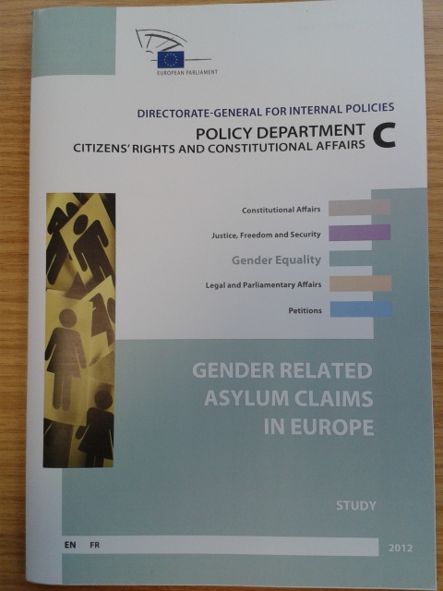

Slide 11
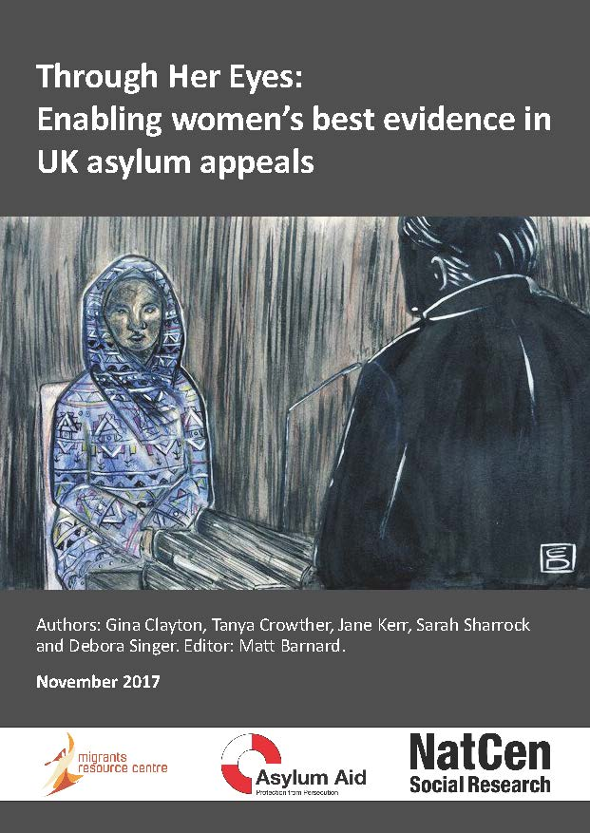

Slide 12
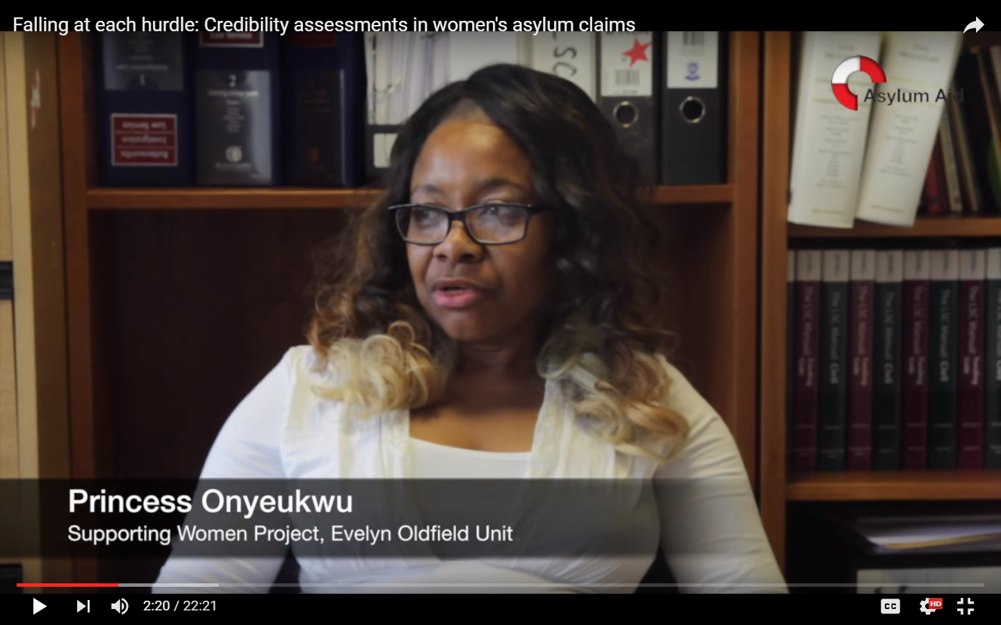
https://www.youtube.com/watch?v=UO0B-C_EPI4&t=2m2s
Notes:
Not being believed is a common experience for women claiming asylum
Film Clip 1 Falling at each Hurdle: 2.02- 5.20

Slide 13
https://www.youtube.com/watch?v=UO0B-C_EPI4&t=11m36s
Notes:
how do women feel about talking about what’s happened to them?
Film clip 2 Falling at each Hurdle: 11.36-13.44

Slide 14
What prevents voice?
Language
Interpreting
Mental health/ shame/ trauma
Cultural barriers
Presence of children
Failure to understand effects of trauma
Culture of disbelief
Not knowing your rights

Slide 15
Protection Gap campaign

